Slide 1
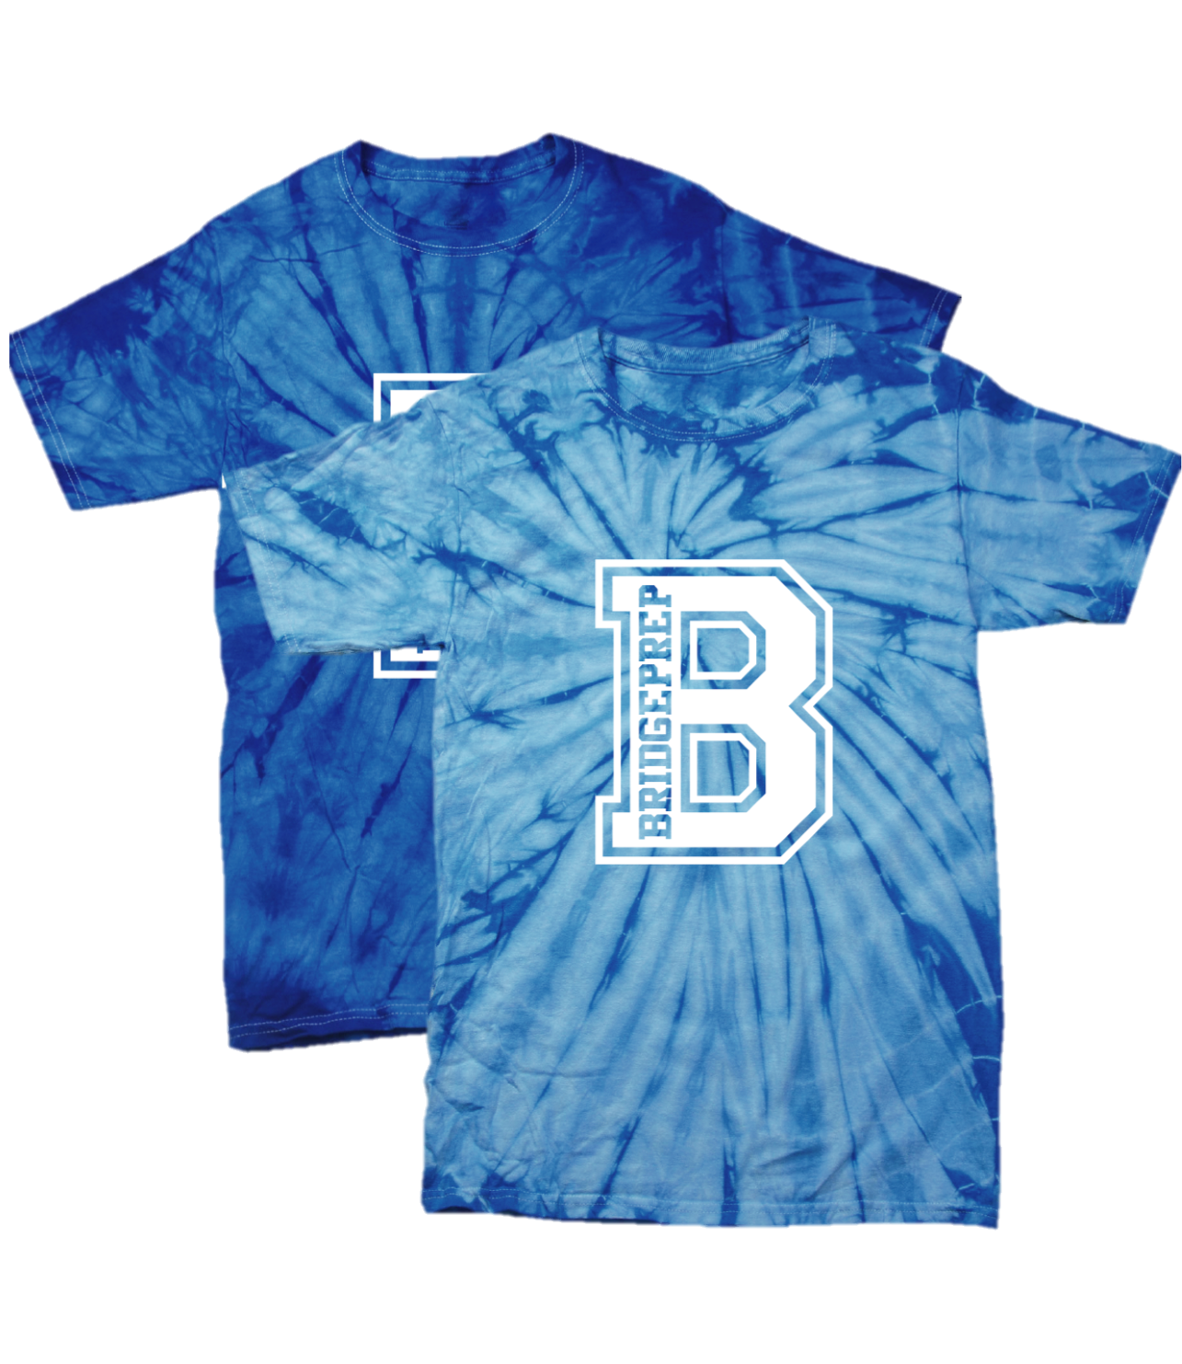
Our Mission Statement
BridgePrep Academy believes every child learns best in a safe, nurturing and stimulating environment where high academic expectations, self-esteem, good character and an appreciation for the arts are promoted. BridgePrep Academy’s mission is to provide a challenging academic curriculum that will encompass an enriched Spanish language program, technology and experiences that will enable students to develop in all areas. BridgePrep Academy’s goal is to educate well rounded individuals and enable students to reach their maximum potential.
BridgePrep Academy
of Hollywood Hills
1400 N. 46th Ave
Hollywood, FL 33021
(954) 362-8268
Rock your Disney side and have a magical day!
Don’t be afraid to make up the most bizarre outfits!
Argh mateys, grab an eye patch and a scarf and prepare to walk the plank!
Wear a shirt to represent your favorite sports team!
K-2nd 12:30pm
3rd-6th 1:00pm
K-2nd 12:30pm
3rd-6th 1:00pm
K-2nd 12:30pm
3rd-6th 1:00pm
Hispanic Heritage Week- October 12-October 16
Hispanic Heritage Zoom- Cooking Class at 6pm
Spirit Shirt Day
Via zoom 6pm-7pm
Spirit Shirt Day
Wear red for Red Ribbon Week .
*** All Calendar Events Are Subject To Change***

